Slide 1
Virtualization

Slide 2



Objectives
At the end of the lesson student should be able to
State what is a virtual machine
Define the term virtualization
Describe the virtualization process in a computer
Outline the concept of paging in a computer.
Explain how segmentation process of a computer memory

Slide 3
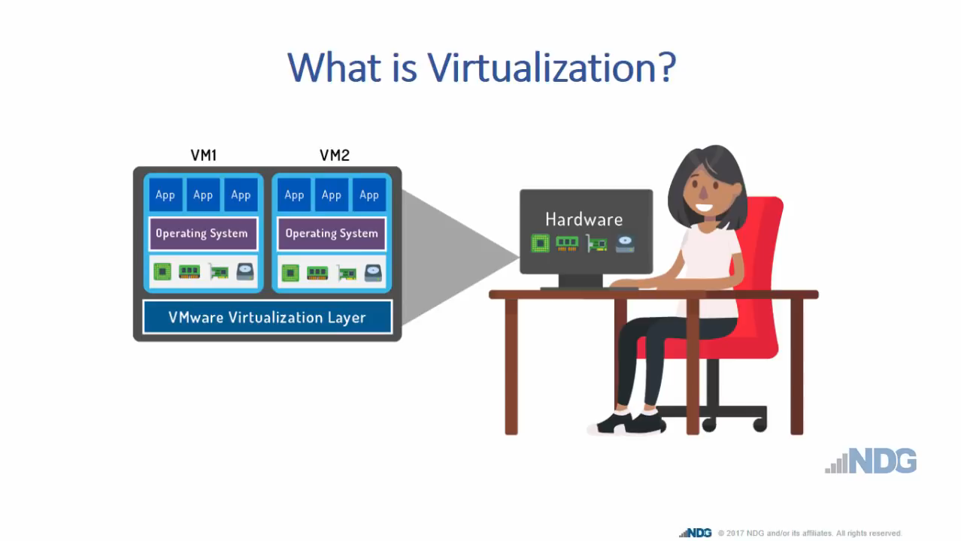
https://www.youtube.com/watch?v=iBI31dmqSX0

Slide 4

Teacher’s summary
What is Virtualization?

Slide 5
VIRTUAL MACHINES
Virtual machines (VMs) are entire operating systems running inside another operating system
A user running Windows 11 could run a virtual machine of MacOS
This would allow them to navigate the GUI of MacOS and install software on it
Running a virtual machine helps access software that is only designed to run on specific operating systems
VM management software includes a Hypervisor that monitors all activity happening inside the VM

Slide 6
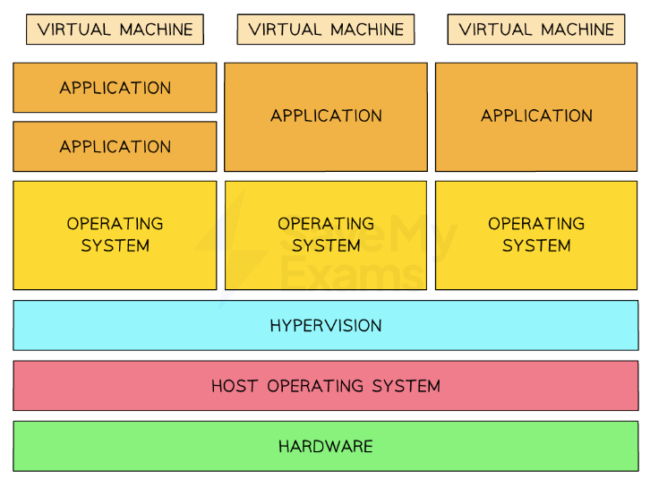
Structure of several virtual machines running on a single piece of hardware

Slide 7
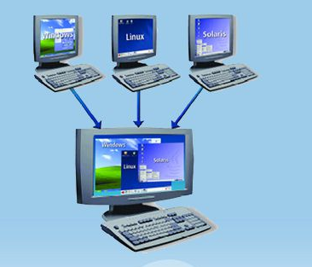
What is a virtual machine?
This is a virtual computer that exist within another computer
It uses a software application designed to look and run like an OS different from the one installed on a computer, mobile device, or even server.
To run a virtual machine (VM), you need to work with a host computer or server that provides the hardware resources. This is called the host machine.
Each virtual machine on a particular host machine is called a guest machine.

Slide 8
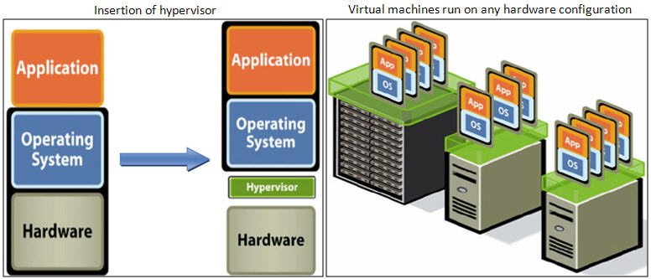
How does virtualization work?
Virtualization allows multiple operating systems to run at the same time on one machine, the combination of systems is called a virtual machine (VM).
The initial piece of hardware operating a VM is called the host.
VMs operating in harmony within the host are called the guests.
A Software called hypervisors separate the physical resources from the virtual environments
Hypervisors take your physical resources and divide them up so that virtual environments can use them
Hypervisors can sit on top of an operating system (like on a laptop) or be installed directly onto hardware (like a server), which is how most enterprises virtualize.

Slide 9
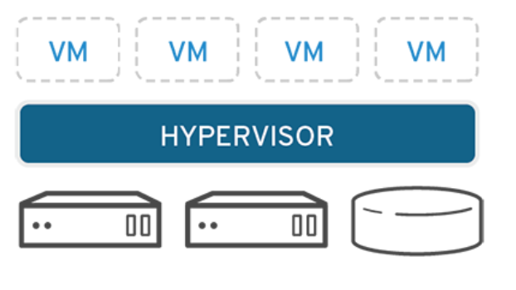
Benefits of Virtualization
Increase flexibility and scalability of a network or server
Cost savings. Reduced operating costs and save on space.
Greater workload mobility, increased performance and availability of resources, automated operations.
Applications and resources are provided more quickly while using virtualization.
Minimized or eliminated downtime.
Increased IT productivity, efficiency, agility and responsiveness.
Faster provisioning of applications and resources.
It helps to continue working if the system crashes or any sudden failures.
Simplified data center management.

Slide 10
Benefits of Virtualization
Cross-platform and forwards compatibility
Not all software is designed to run on all operating systems
Apple commonly makes software that only runs on MacOS for performance reasons
A Windows user could run a virtual machine of MacOS and install the software they need
Most software needs to be updated to work on the latest versions of operating systems
A user running the latest release of Windows may need to run a virtual machine of a previous release of Windows to use an application that hasn't received a forwards-compatibility update

Slide 11
Benefits of Virtualization
In software testing
VMs are a way to create isolated test environments, that leave the host operating system unaffected
Isolated environments allow a developer to:
Monitor the way their software affects system performance
Test on a clean-slate system, while no other applications are running
VM management software can create virtual machines that act like they have older hardware
This allows developers to build software that can be run on older hardware so that more users can use the software
A developer can test against various operating systems, such as MacOS, Linux and Windows, for greater compatibility
This is achieved through compiling into intermediate code and running against different operating systems

Slide 12
Benefits of Virtualization
In software testing
VMs are a way to create isolated test environments, that leave the host operating system unaffected
Isolated environments allow a developer to:
Monitor the way their software affects system performance
Test on a clean-slate system, while no other applications are running
VM management software can create virtual machines that act like they have older hardware
This allows developers to build software that can be run on older hardware so that more users can use the software
A developer can test against various operating systems, such as MacOS, Linux and Windows, for greater compatibility
This is achieved through compiling into intermediate code and running against different operating systems

Slide 13
Question
Explain why the programmers of anti-virus software may make use of virtual machines when developing the updates. [3]

Slide 14
solution
Virtual machines (VMs) are essential in developing anti-virus software updates for several reasons. VMs create an isolated environment that is separate from the host operating system. This enables developers to safely work with virus test code that could risk the integrity of their own operating system. VMs can also be configured to emulate various types of hardware. This allows developers to understand how their anti-virus software will perform on different devices and under different conditions, ensuring a wider range of compatibility.
Acceptable answers you could have given instead:
Virtual machines create an isolated test environment from the host operating system. This means working with harmful test code carries less risk. Virtual machine management software can monitor the VM through the Hypervisor. This will show how the software affects VM system performance, allowing the programmer to make changes where needed.

Slide 15
solution
Recall two benefits of using virtual machines in developing software
Link these benefits to some considerations needed when developing anti-virus software

